Slide 1
Team
Kryptx
A Perfect Solution For
BLIND.
Organization Name: AICTE-MIC
Problem Statement: Student-Innovation
Team Name: Kryptx
Team Leader Name: Sebin Byju

Slide 2
Problem Statement
Some people dream of the serene beauty of this world as their eyes are filled with darkness – called as visually impaired. Technology is trying its best to serve these people. So our problem was to tackle the challenges faced by visually impaired people to help them in experiencing the world as everybody else with the assistance of technology.
To be more clear, the product is a complete solution to visually impaired to experience the world as others

Slide 3
Our Team
Sebin Byju
Roval Benny
Royal Benny
Chrisbin Sunny
Vaishnavi S
Rose Maria MT
Team
Kryptx

Slide 4
Technical Stack
01
Raspberry Pi
02
Server
03
Camera
The microcontroller module serving as client
The model building and processing is done here
To capture the real time images of surroundings
04
Speaker
05
Mic
06
Google Vision API
To tell the user about the processed instruction
To give commands to Kryptx frame by user
Used for text recognition

Slide 5
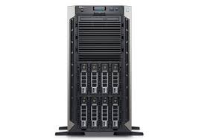
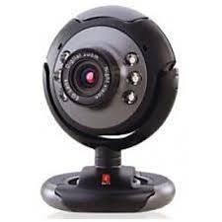
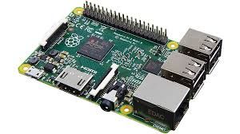
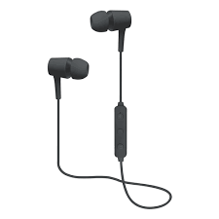
Work-Flow
Images from camera sends to server
Camera captures images in every 3 seconds and send it to raspberry pi
Text sends by server converts into audio
Server process all the data. The result is sends to the raspberry pi in text format.

Slide 6
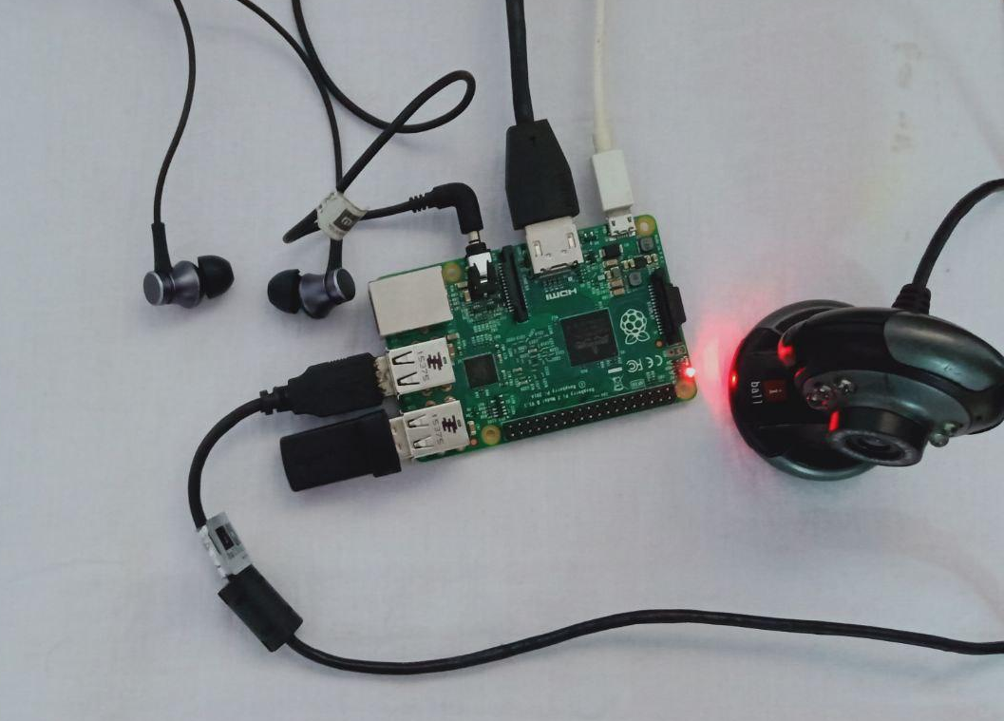
Our Hardware
Raspberry Pi
Ear Piece
Camera Connector
Camera

Slide 7
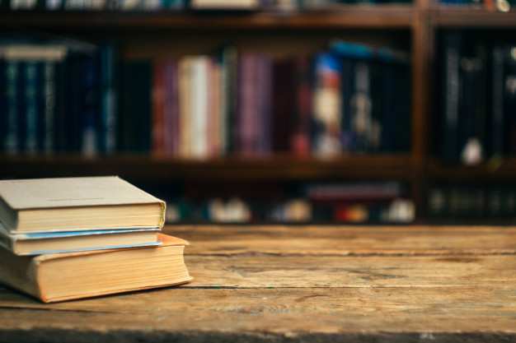
OUR CAMERA CLASSIFICATION
Left
Centre
Right

Slide 8
Why our product is the first in line of
Visually Impaired Aid?
Our product is the most compact solution for visually impaired
The available products serve a single purpose whereas our product serves multiple purpose
Our product is user friendly where those who use it feels just like he is wearing a sunglass
The mental trauma of being a disabled can be eliminated when he can experience the real world as like others
Finally, all the features essential for a blind can be provided by our Kryptx

Slide 9
Our Key Features
READING
MEDICINE NAME DETECTION WITH REMINDER
IDENTIFY PEOPLE
Read any text includes newspaper, medical prescriptions,, etc..
Detects the medicine and alert the user on time
Identify people as like common man with their expression.
OBJECT IDENTIFICATION
SIGN BOARD
CURRENCY COUNTING
Identifies the object in front of the user and its relative position
Recognizes sign boards,
Zebra lines, bus board, etc..
Identify and count
the currency.

Slide 10
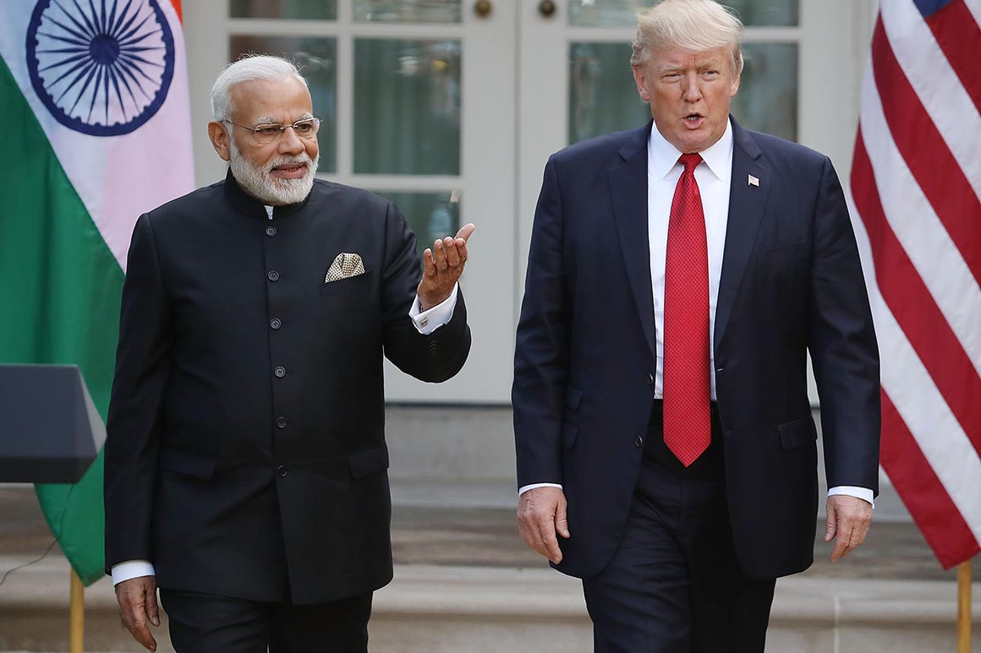
Face Recognition with Expressions
Face detection libraries are used to detect faces and face recognition function recognizes the name of the person.
Library Used: Face Recognition (1.3.0)
Narendra Damodardas Modi (Happy)
Donald J. Trump (Talking)

Slide 11
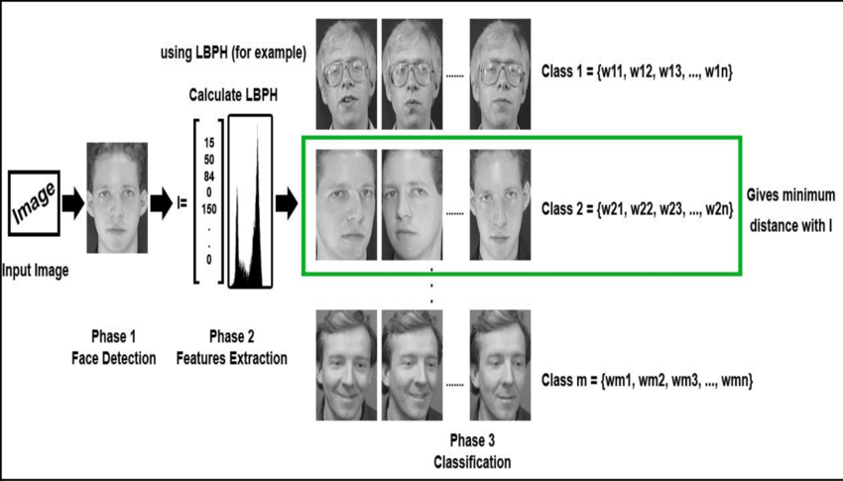
Working

Slide 12
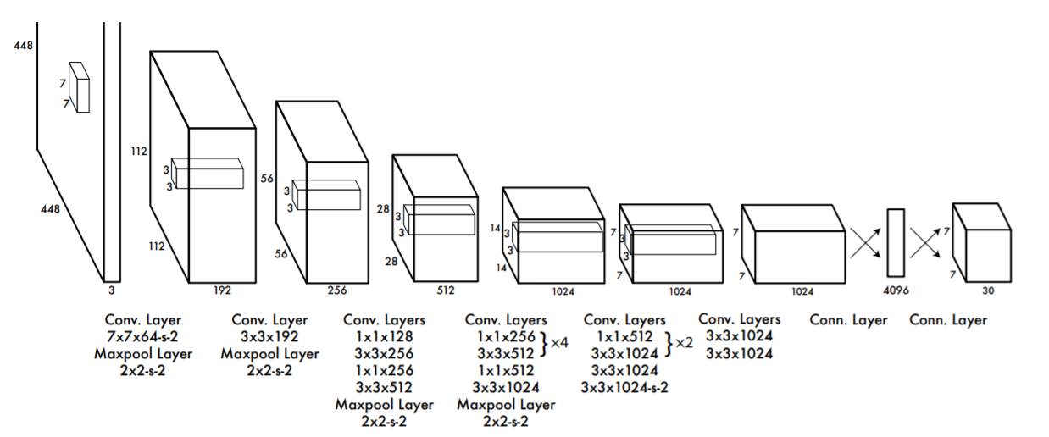
Object Detection
Technology Used: YOLO Algorithm

Slide 13
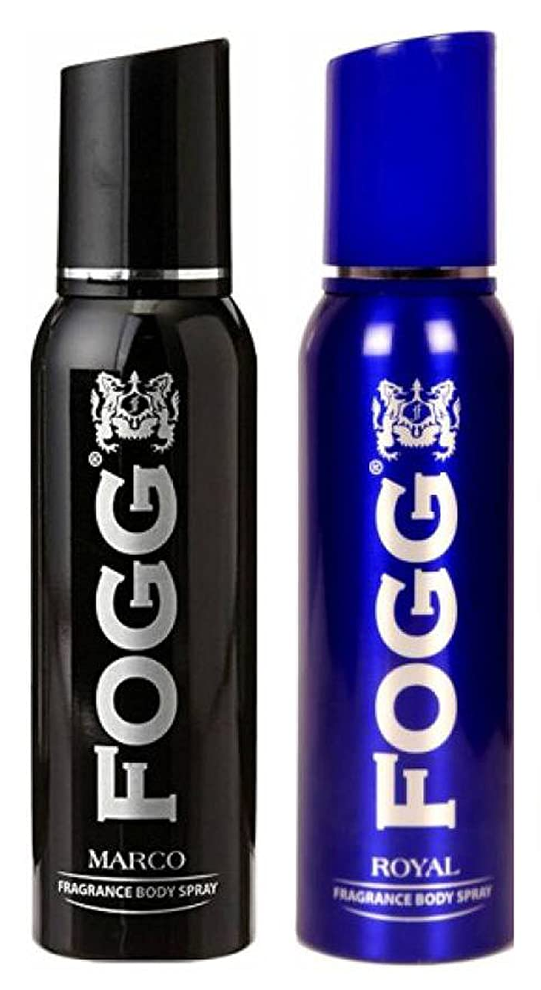
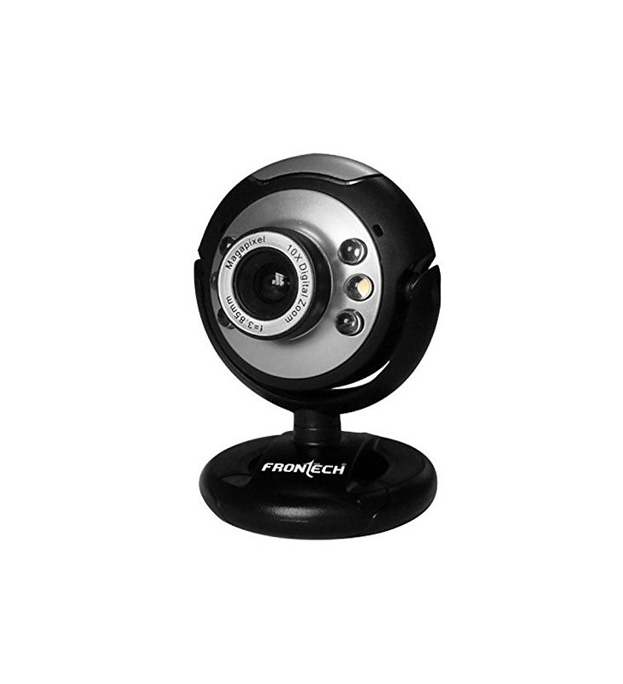

Text Recognition
The text to be processed is detected by the camera and using the cloud vision API, process it as per need and returns the output to the speaker of our Kryptx frame
Natural Language Detection
FOGG

Slide 14
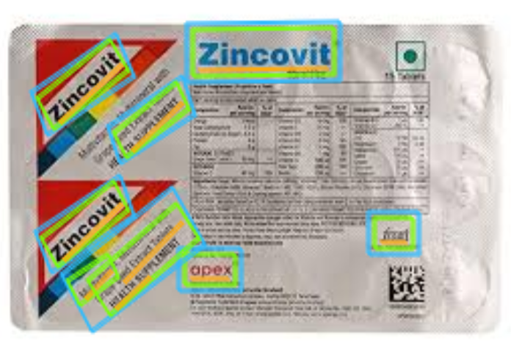
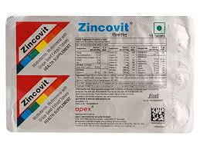
Medicine Detection
In medicine detection, we scan the text on the back of cover and identifies the large text which probably is the name of the medicine and also adds a remainder in the program to alert the user about the time to consume the medicine
Zincovit

Slide 15
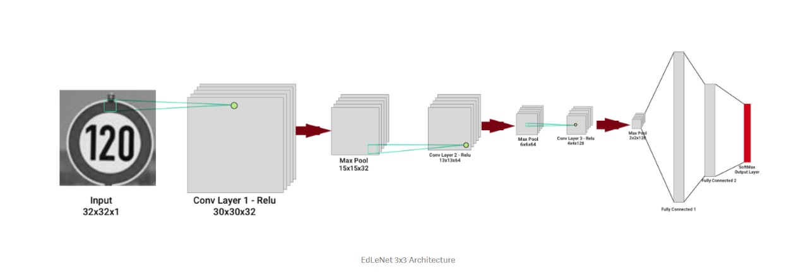
Sign-Board Detection
In sign-board detection we use deep learning to classify images is to build CNN using Keras library.
Technology Used: Model Architecture (EdleNet)

Slide 16
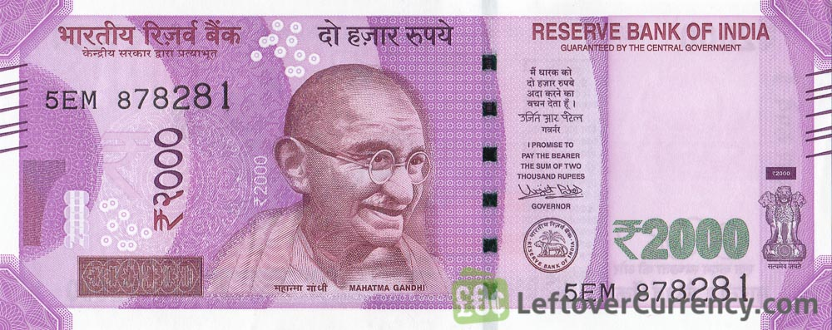
Currency Identification
The user requesting the Kryptx frame to identify the currency note, where the camera captures and uses deep learning model and builds a CNN using Keras Library which detects the currency note and send it to Kryptx frame as audio to speaker
EdleNet Algorithm
2000 RS

Slide 17
Products Available In Market
Blind Aiding Radar
Robotic Guide Dog
Mygo Cane
IrisVision

Slide 18
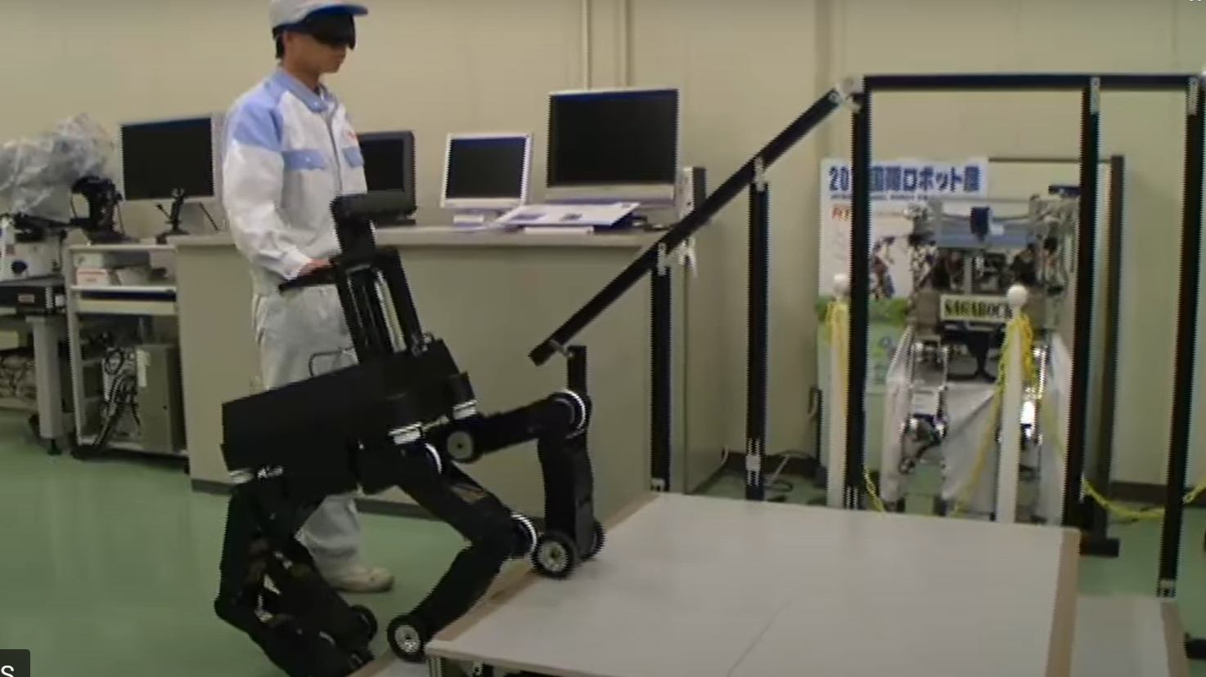
Robotic Guide Dog
Japanese manufacturer NSK developed the robotic guide dog
The robot takes the four-legged form, so in a way it's like having a seeing-eye dog
Incorporated only with voice recognition for command purposes
Used to guide the blind only in his locomotion
Source : https://www.trendhunter.com/trends/robotic-guide-dog

Slide 19
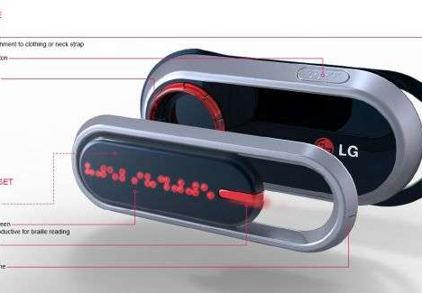
Blind Aiding Radar
The Ben-Gurion University of the Negev in Israel has developed new radar systems for the blind
Uses radars to scan areas and alert the user through a only series of beeps when there is something ahead
Searches for objects which are pre recorded in the person's field of vision
Inadequate if something new obstacle comes in front of him
Source : https://www.trendhunter.com/trends/radar-systems-for-the-blind

Slide 20
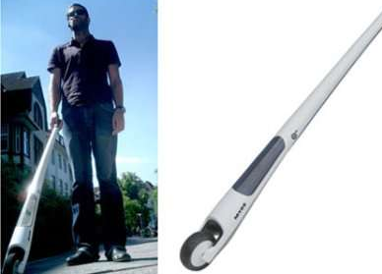
Mygo Cane
A German student invention
Is a stick for blind
A system with a smart sensor and camera combo which is capable of measuring the ground area accurately in real time while pushing auditory feedback to a headset.
Meant only for smooth locomotion
Source : https://www.trendhunter.com/trends/mygo-cane-could-replace-seeing-eye-dogs

Slide 21
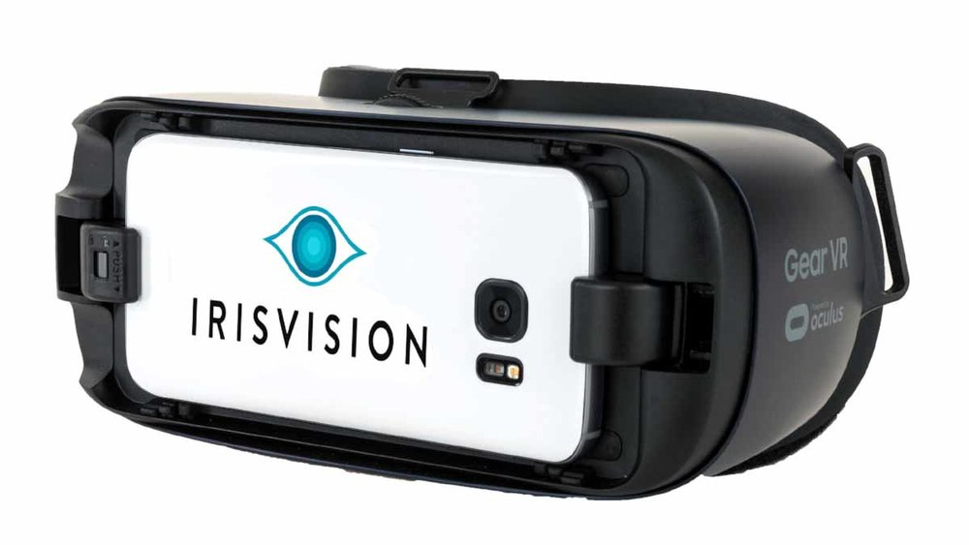
IrisVision
An assistive technology solution for vision enhancement, wearable low vision aids in the market
Electronic glasses, comprised of a smartphone mounted VR headset, which captures the images and offers just a magnified view of the objects
‘IrisVision Assistant’ to enable users operate this low vision device through voice commands, truly making it ‘hands-free’
Source : https://irisvision.com/devices-that-can-help-legally-blind-live-independently

Slide 22
Thank You
TEAM KRYPTX

